Slide 2
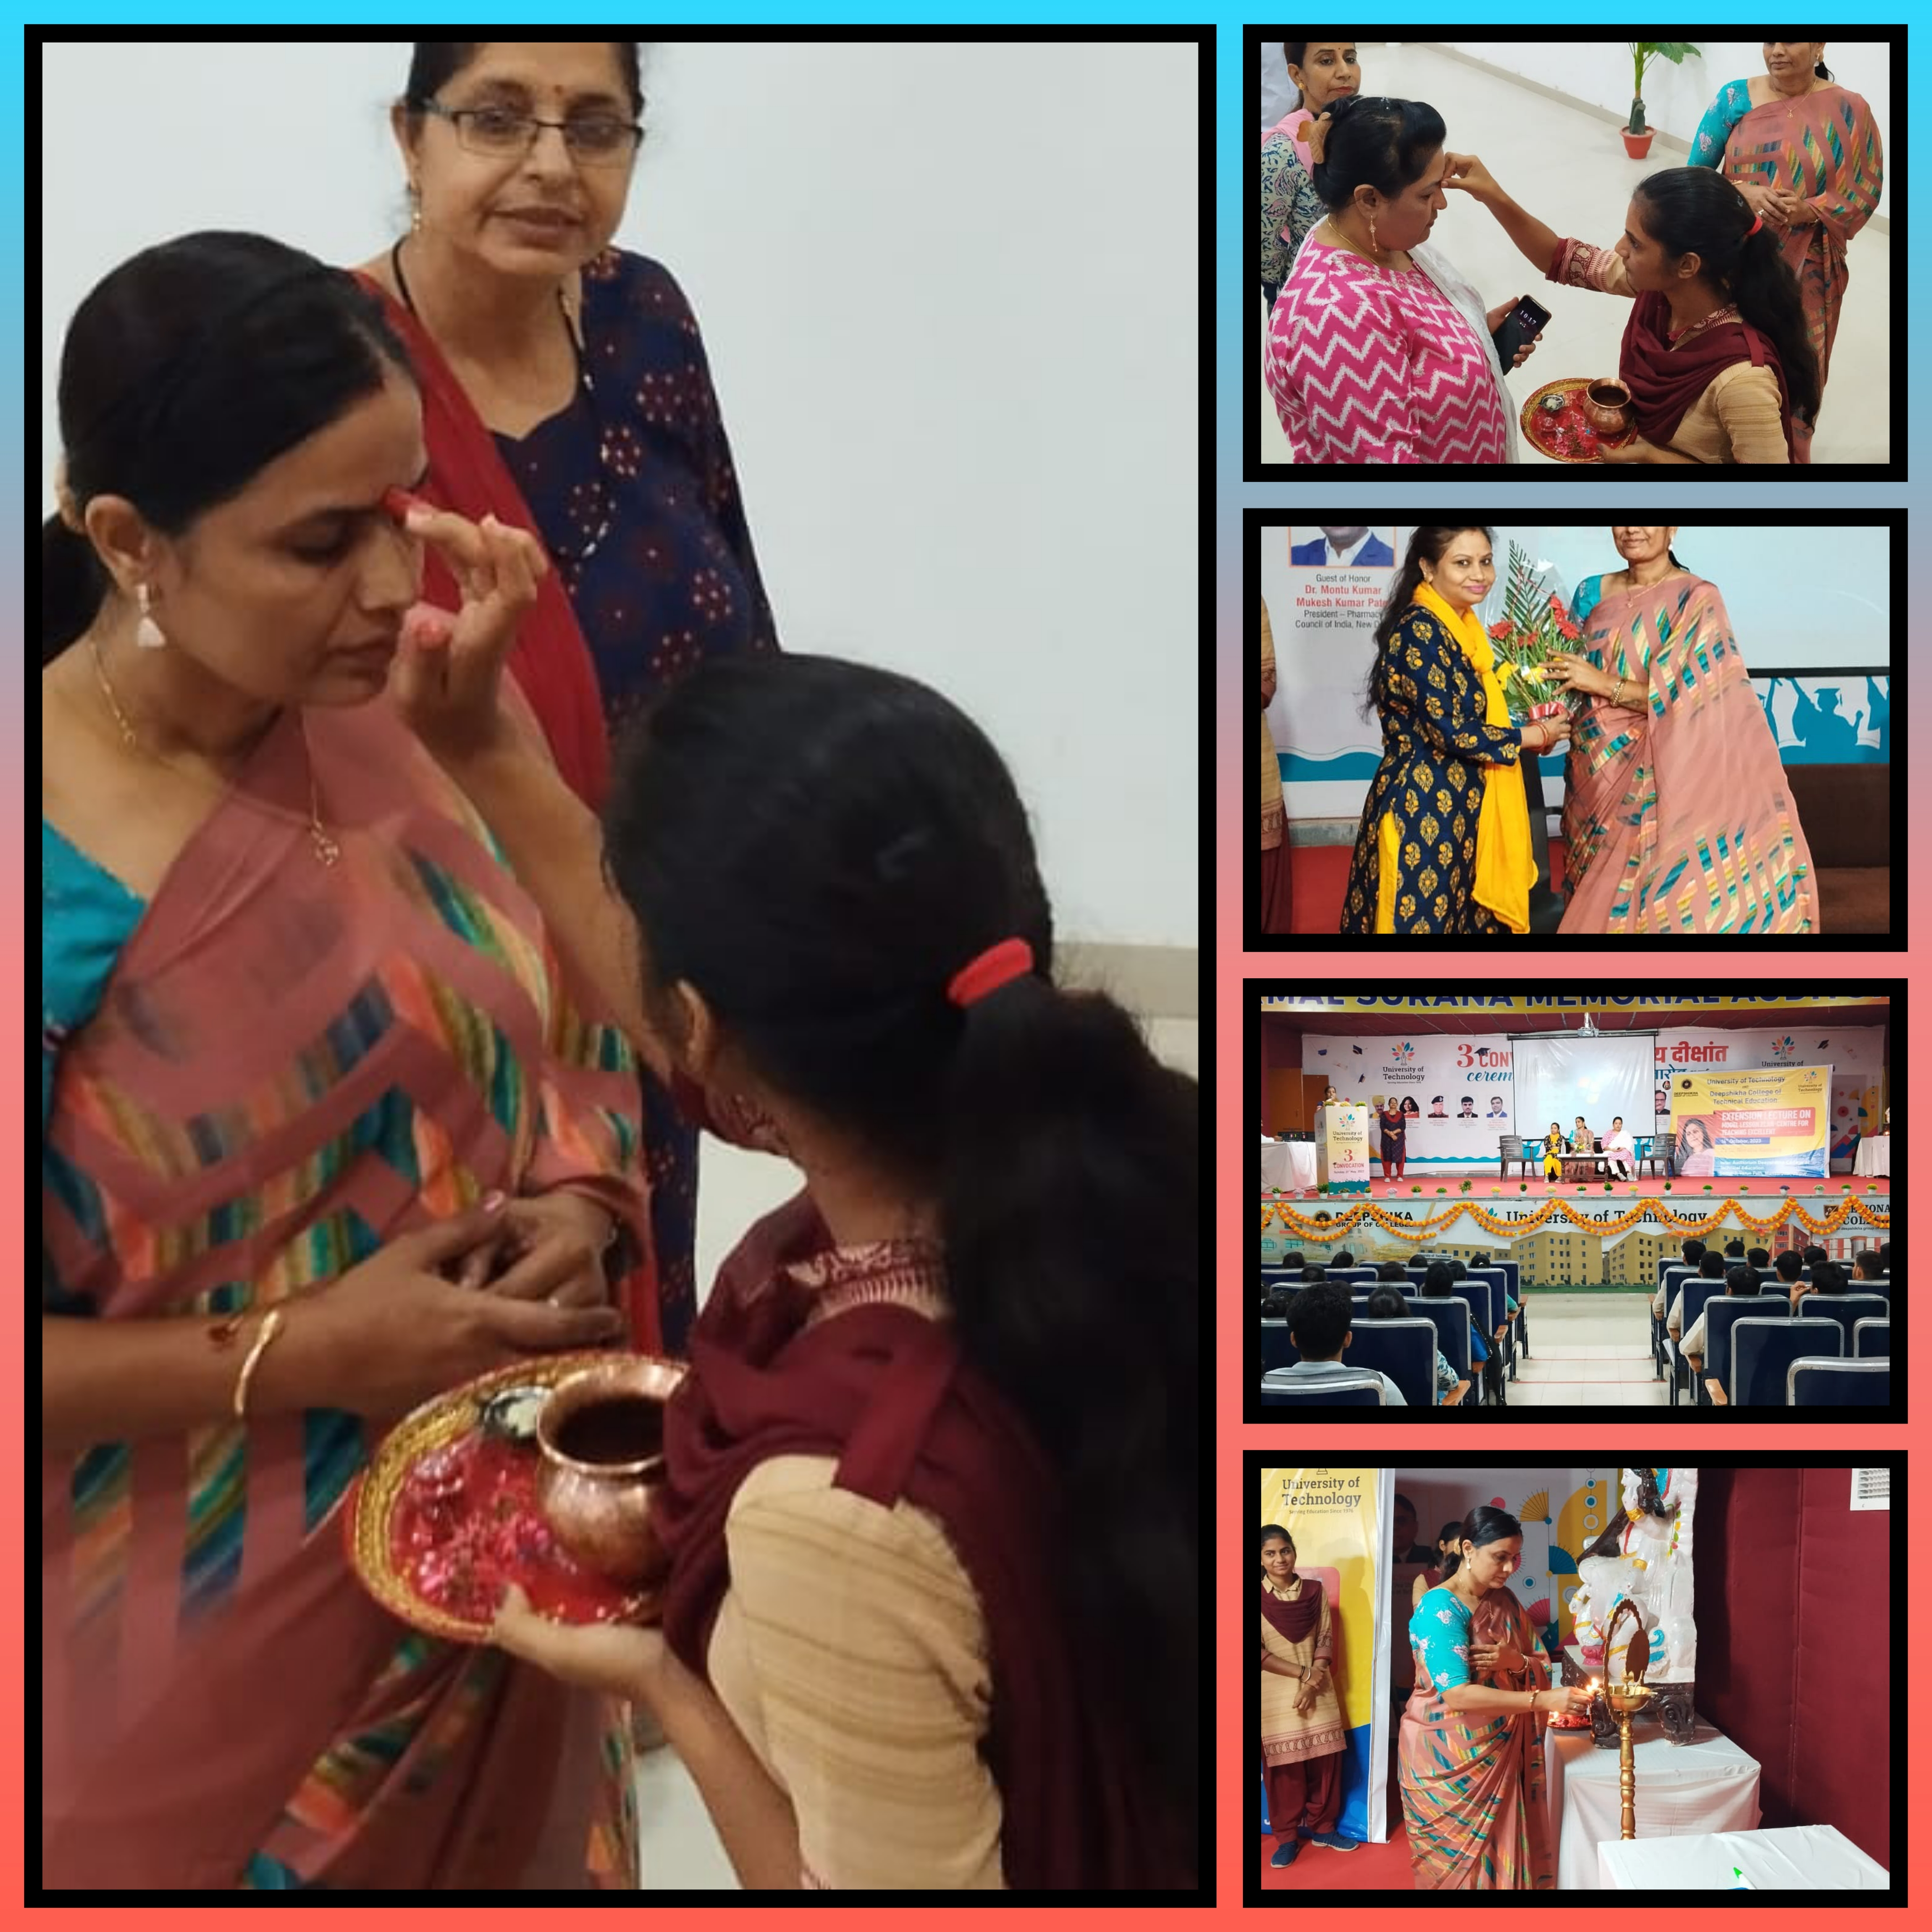
Welcome Gesture

Slide 3
KEY SPEAKERS
The seminar was started with the welcome speech by Dr. Anila Sharma, (principal of the Deepshikha Kala Sansthan) after the keynote address was given by Dr. Sheetal Kansara Ma’am (Principal of Jashoda Devi T. T. college)
Guest Dr. Sheetal Kansara Ma’am and Dir. Of Deepshikha College Dr. Rita Bisht Ma’am lighten the lamp.

Slide 4
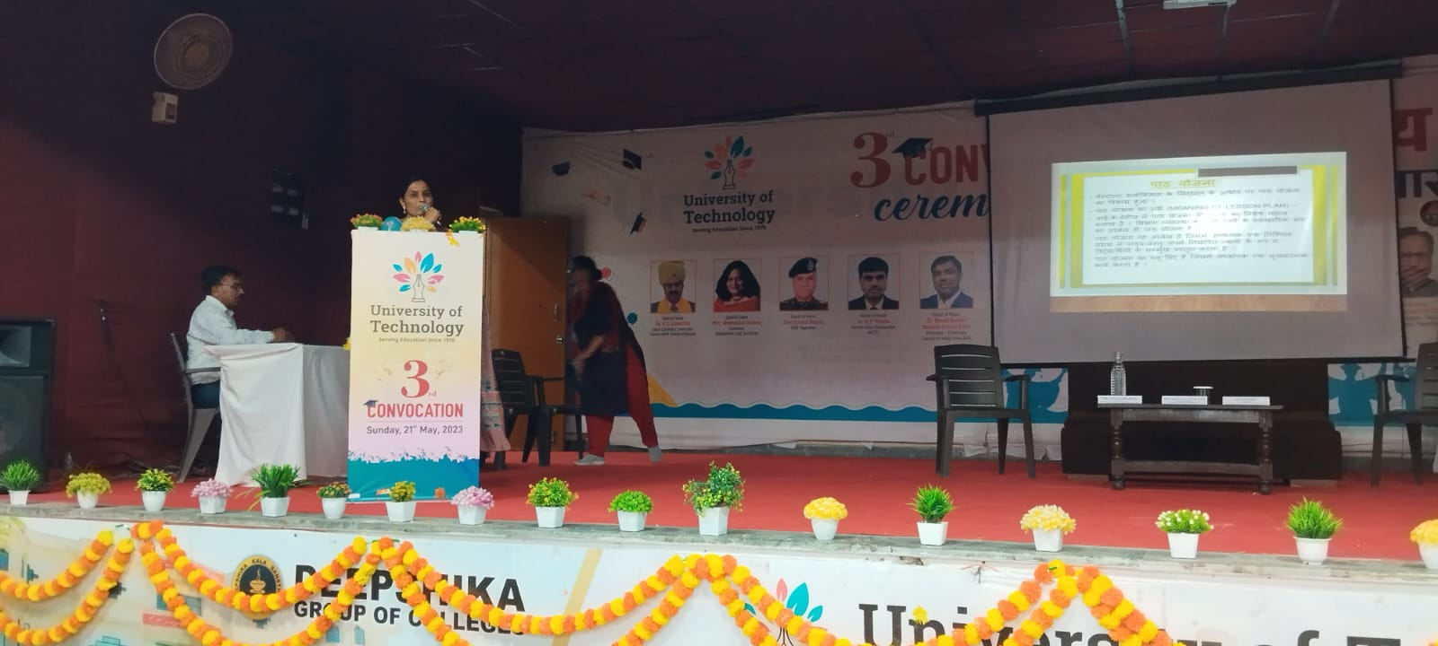
INTRODUCTION
Extending Knowledge and Enhancing Skills :-
A Comprehensive Report on the Extension Lecture Seminar. This presentation aims to provide a detailed overview of the extension lecture seminar, its objectives, and outcomes. It will also highlight the importance of extending knowledge and enhancing skills in today&amp;apos;s competitive world.

Slide 5
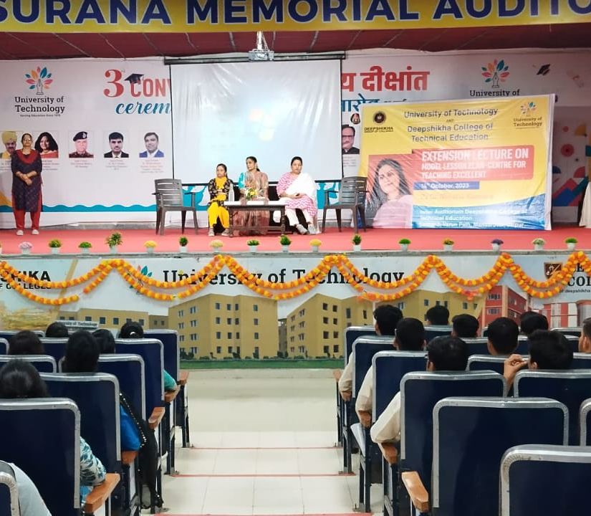
OBJECTIVE OF THE SEMINAr :-
The extension lecture seminar aimed to provide a platform for individuals to learn and develop new skills. It aimed to enhance their knowledge base and provide an opportunity to interact with experts in their respective fields. The seminar also aimed to promote networking among participants.

Slide 6
I. Lesson plan acts as a guide for the teacher as to what and how he has to teach. 2. Through path planning, the teacher understands well the objectives of the path. 3. Proper connection of the new path with the previous path is established. 4. It forces the teacher to think about and use supporting materials. 5. The reading material is organized according to the time. 6. It helps the teacher to choose the best teaching method.
IMPORTANCE OF LESSON PLAN :-

Slide 7
MEANING & DEFINITION OF LESSON PLAN
Lesson planning is done by the teacher keeping in mind his/her curriculum, learning and teaching principles.
Teaching is a written plan made on the basis of prior thinking.
According to Davis, “Lesson planning is a practical outline of all aspects of the teaching system.”
Dr. R. A. According to Sharma, "The activities which the teacher undertakes to achieve the objectives of teaching"
does planning, his article is called a lesson plan."

Slide 8
OUTCOMES OF THE SEMINAR
The seminar was a success in achieving its objectives. Participants reported increased knowledge and improved skills in their respective fields. They also reported enhanced confidence and motivation to pursue their goals. The seminar provided a platform for networking and collaboration among participants.

Slide 9
CONCLUSION
In conclusion, the extension lecture seminar was a valuable.
learning experience for all participants. It provided a platform.
for individuals to extend their knowledge and enhance their .
skills. The seminar also promoted networking and.
collaboration among participants. We hope that this.
presentation has provided a comprehensive overview of the seminar and its outcomes.

Slide 10
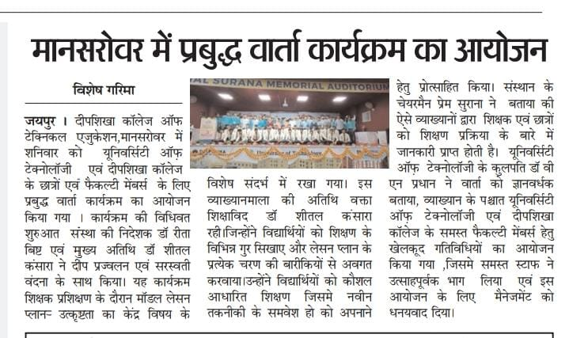
NEWS -SECTION

Slide 11
VOTE OF THANKS
The seminar was ended with the vote of thanks given by Mrs. Sunita Yadav(Head Of The Department Of
B. SC B. ED)

